Slide 1

BRAINPOWER
Ocr FEATURE PROTOTYPE
Notes:
Hello, this is a presentation of my feature prototype for BrainPower, a multi-modal, hybrid, accessible Automated Essay Scoring System. The feature that I will be prototyping is the OCR component. The model is paddleOCR and the objective of this presentation is to determine PaddleOCR’s ability to accurately extract handwritten text from an image file

Slide 2
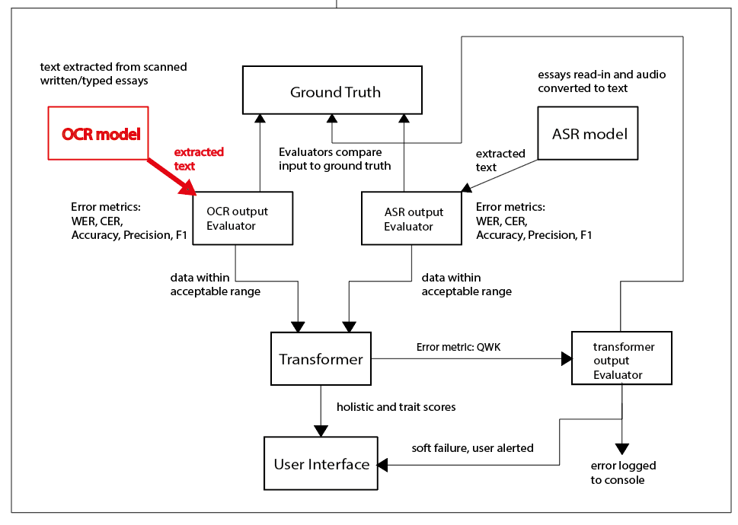
architecture
Notes:
Highlighted in red is the model’s position in the AES pipeline, it facilities handwritten essays input as image files and its output flows to the evaluator unit then to the transformer.

Slide 3

Justification for selection
Position in the AES pipeline
Error Propagation
Controlled experimentation
Notes:
Why was this component selected over the Speech-to-text or the Transformer models: Three main reasons
Its position in the AES pipeline: this represents the first stage in the AES processing pipeline as output from this stage is fed into the Transformer component.
Prevention ofrror Propagation: Errors from this component can propagate to the Transformer resulting in inaccurate essay scores.
Controlled experimentation: the process of handwriting an essay (copying in this case from a reference essay) allows the component to be evaluated under controlled and repeatable conditions.

Slide 4
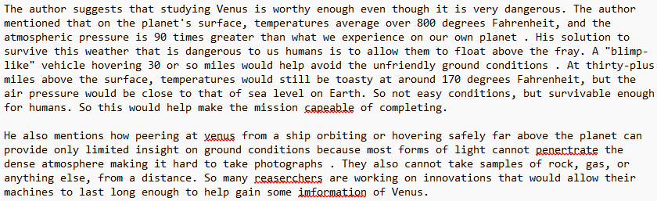
Phase 1 – Essay preparation
The GROUND TRUTH
Notes:
These are the first two paragraphs of the essay titled: Exploring Venus from the ASAP 2.0 dataset. This reference essay will be handwritten and the samples used to evaluate the performance of the OCR component.

Slide 5
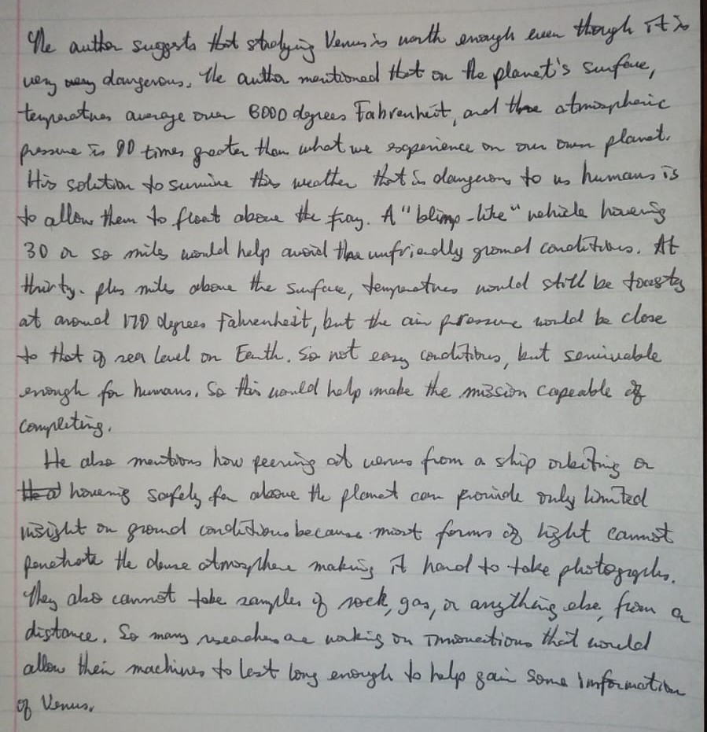
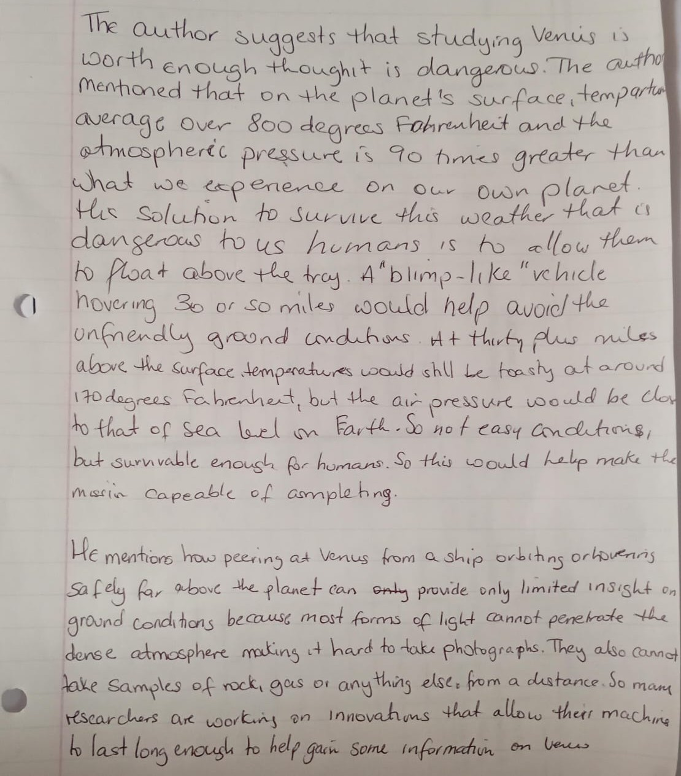
Phase 2 – Essay capture
Notes:
The limited sample size of only two handwritten essays, is sufficient for the objective of this demonstration in supporting accessibility, justifying the inclusion of the OCR component in the AES pipeline.

Slide 6
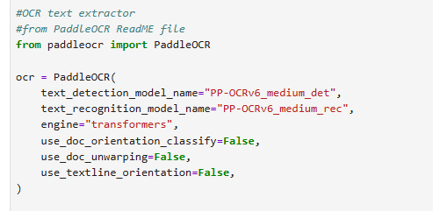
Phase 3a – ocr eXTRACTION
Notes:
The stages in the extraction pipeline are detection, extraction and evaluation, the corresponding parameters are set in Jupyter Notebook.

Slide 7
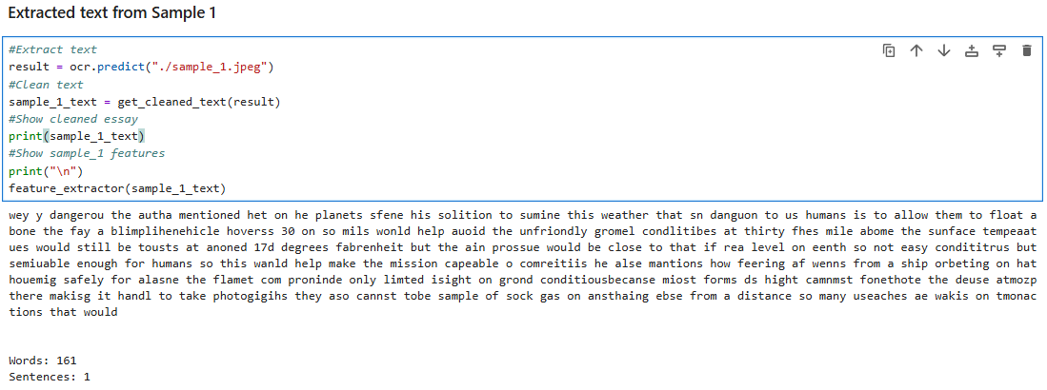
Phase 3b – ocr eXTRACTION
Notes:
After extraction, the text is normalized prior to performance evaluation, by removing punctuation characters that inflate the word count.

Slide 8
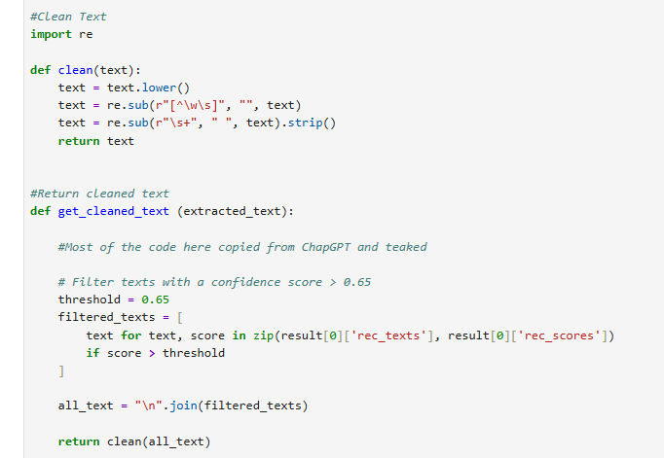
Normalisation
Notes:
The normalization involves removing punctuation characters from the extracted text so that only words remain, thereby facilitating a fair comparison between the ground truth and the samples.
A confidence score with a threshold is set to 0.65 is used to filter out text that is likely to be spurious from propagating through the AES pipeline.

Slide 9
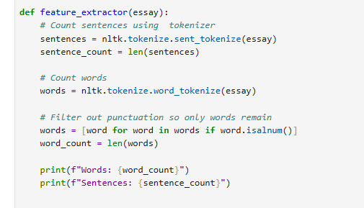
Feature Extraction
Notes:
To extract features from the essays. The Natural Language Toolkit (NLTK) library is used to tokenize words and sentences to allow statistical measures to be taken of the features of the essays. These statistics will then be input as hand-crafted features to improve the interpretability of the essay evaluation performed by the Transformer model.

Slide 10
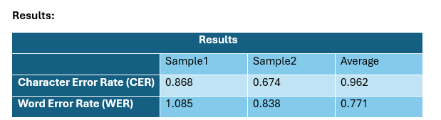
Phase 4 – WORD AND ERROR RATE CALCULATIONS
Notes:
These results show that the OCR component successfully extracted handwritten text and converted it to digital text. They also show the success criteria being satisfied as all figures obtained fall below the 2% ceiling.

Slide 11
Limitations
Sample Size
Notes:
The sample size was very small and as such is not sufficient to comprehensively evaluate the performance of the OCR model as it was not representative of the real-world conditions that essays will have to be written, captures and submitted under.

Slide 12

Thank You
Notes:
This presentation has demonstrated that paddleOCR is an essential addition to the AES system, in promoting accessibility. The results shows the model performed acceptably indicating its ability to accurately extract handwritten text from and image and convert it to digital text. However, the presence of errors indicates the need for mitigation which will be implemented with future developments to the system.

